Slide 1

Introduction to Long Read Data Analysis
Álvaro Cortés C.

Slide 2
Overview
Introduction to sequencing data formats
FASTQ
FASTA
BAM
VCF
Output Long read sequencing devices
Pacbio (Subreads, CCS, Hifi)
Oxford Nanopore (fast5 files)
Improving base calling
Encoding epigenetic information on BAM files

Slide 3
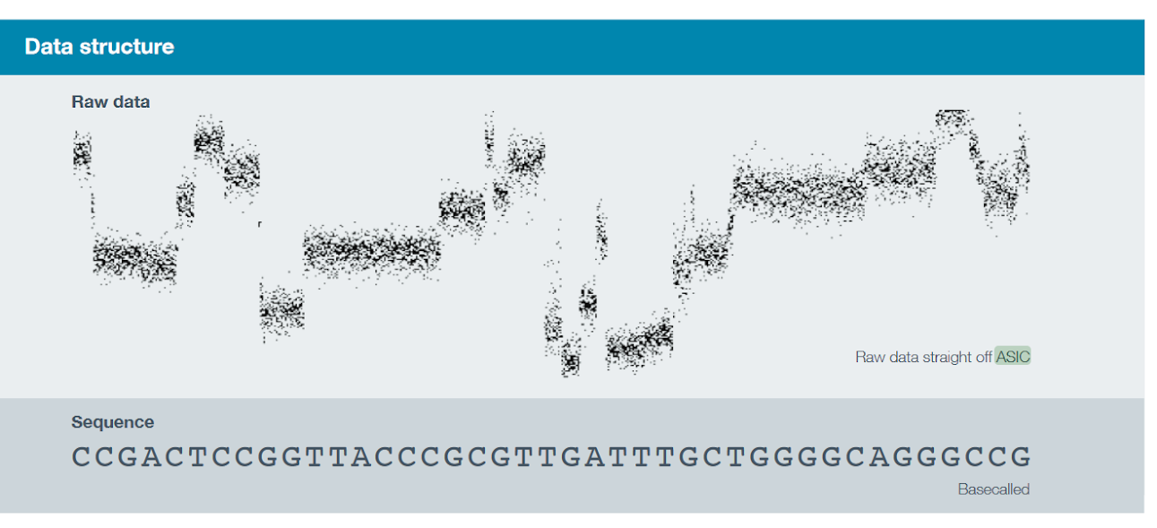
Base Calling Oxford Nanopore
Conductivity (or Resistance) Varies by Base
Current (pico Amperes) is measured: “Squiggles”
Conductivity is calculated and stored as a 16-bit Integer value
Base calling transforms measured conductivity into bases

Slide 4
Long read Common Pipelines
Sequencing
Base calling
ISO-form discovery
DNA (RNA)
Fastq/uBAM
Denovo
Assembly
Mapping
DNA
RNA
Variant Calling
Structural Variation
Differential Expression
Relative Expression
Epigenomics

